Slide 1
Stripe on iOS
Mobile credit card transactions made easy
Daniel MacKenzie

Slide 2
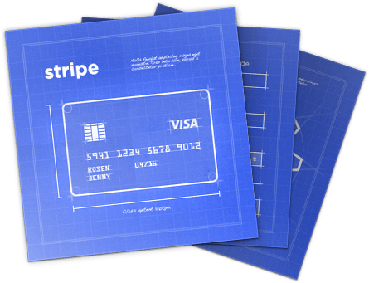
What is Stripe?
Online platform that makes accepting credit card payments simple
Cross-platform solution for developers

Slide 3
Features
Full-stack payments – no need for a merchant gateway
PCI compliant
Client APIs for Android, iOS, and web
Server APIs for Ruby, Python, PHP, and more
Set up subscriptions and recurring payments
Create and save customer info for future use
Online dashboard with statistics

Slide 4
Pricing
2.9% + $0.30 per successful transaction
$15 fee per chargeback
No hidden or monthly fees
Minimum $0.50 per transaction

Slide 5
Benefits
Fully customizable payment experience
All processing fees returned on refunds
Easy integration
Accept payments from major credit cards
Stripe handles most of the security issues

Slide 6
Drawbacks
Only for businesses in Canada in the US
7 day delay before deposit of funds

Slide 7



Transaction Lifecycle
1
Client
2
4
5
3
6
Your Server

Slide 8
Demo

Slide 9
Questions?

